Slide 1
Export an Eclipse project as an archive file

Slide 2
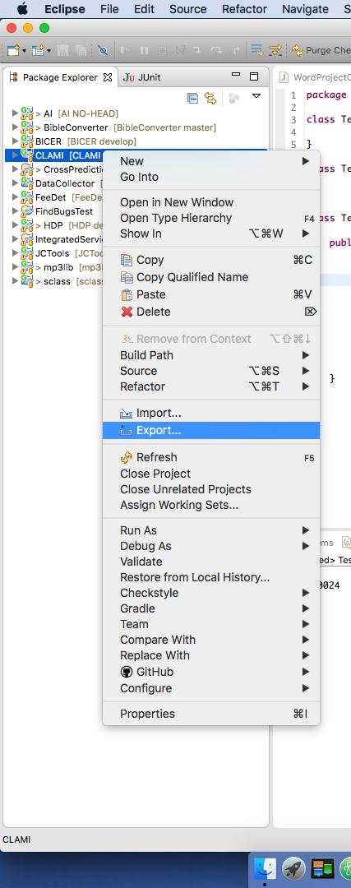
Export
Pop-up menu on a project
Export

Slide 3
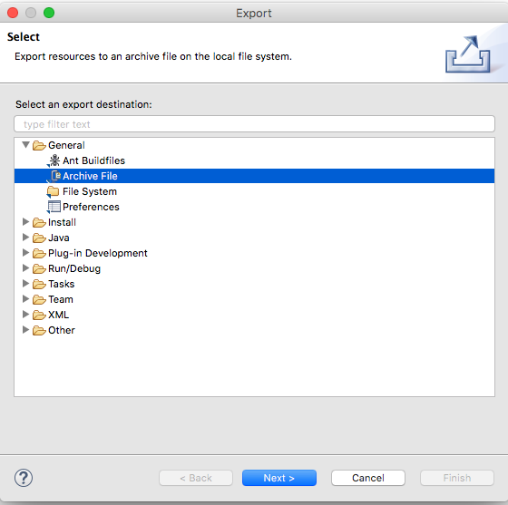
Choose Archive File
General
Archive File
Next

Slide 4
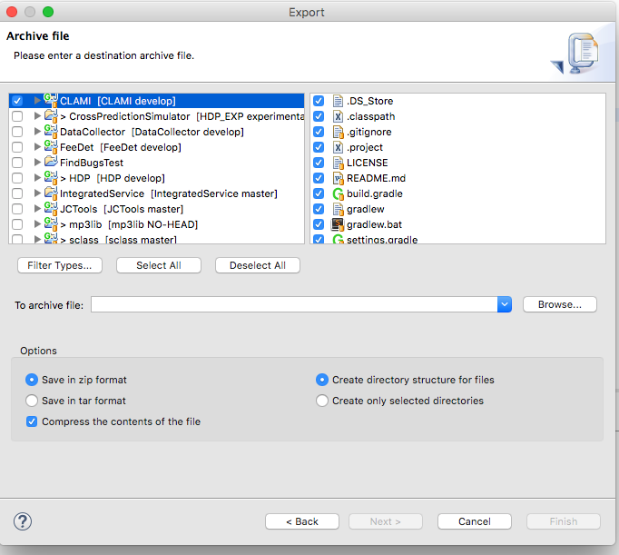
Choose a project to export as an archive file
Tick the target project
Click Browse
Save a zip file in a specific directory such as Desktop.

